Slide 1
BigProject Report
Design of 2.4 GHz BLE Transmitter with Wake-Up Receiver (WuRx)
Project 4: Sensor node BLE and Directional coupler
Supervisor: Dr.NGUYEN Van Hieu
Subject: Microwave Engineering
Group: N_04

Slide 2
Thành viên của nhóm
STT | Họ và Tên | MSSV | Nhiệm vụ | Tiến độ
1 | Lâm Gia Bảo | 2210214 | Viết chương trình cho Node | 100%
2 | Trần Quốc Bảo | 2210278 | Thực hiện làm mạch PCB | 100%
3 | Hà Xuân Cát | 2210342 | Thực hiện thiết kế kiểm định Schematic | 100%
4 | Lý Đoàn Dự | 2210631 | Thực hiện thiết kế kiểm định Schematic | 100%
5 | Võ Phát Đạt | 2210725 | Thực hiện làm mạch PCB | 100%
6 | Trương Nguyễn Nhật Đông | 2210779 | Thực hiện làm mạch PCB | 100%
7 | Nguyễn Đại Đồng | 2210780 | Viết chương trình cho Node | 100%
8 | Đỗ Tiến Giáp | 2210838 | Thực hiện mô phỏng Directional Coupler | 100%

Slide 3
Table of contents
01
02
03
04
05
06
Statement
Hypothesis
Objectives
You can describe the topic of the section here
You can describe the topic of the section here
You can describe the topic of the section here
Methodology
Analysis
Conclusions
You can describe the topic of the section here
You can describe the topic of the section here
You can describe the topic of the section here

Slide 4
01
Statement
You can describe the topic of the section here

Slide 5
Purpose statement
What about Mercury?
Mercury is the closest planet to the Sun and the smallest one in the Solar System—it’s only a bit larger than the Moon. The planet’s name has nothing to do with the liquid metal
What about Venus?
Venus has a beautiful name and is the second planet from the Sun. It’s terribly hot—even hotter than Mercury—and its atmosphere is extremely poisonous
What about Jupiter?
Jupiter is a gas giant and the biggest planet in the Solar System. It's the fourth-brightest object in the night sky. It was named after the Roman god of the skies and lightning

Slide 6
98,300,000
Big numbers catch your audience’s attention

Slide 7

A picture always reinforces
the concept
Images reveal large amounts of data, so remember: use an image instead of a long text. Your audience will appreciate it

Slide 8
Awesome words

Slide 9
Situation & problems statement
1
2
3
Current situation
Earth
Mars
Mercury
Jupiter is a gas giant and the biggest planet in the Solar System. It's the fourth-brightest object in the night sky. It was named after the Roman god of the skies and lightning
Earth is the third planet from the Sun and has life
Despite being red, Mars is actually a cold place
Mercury is the smallest planet in the Solar System
Problems

Slide 10
Hypotheses
1
Hypothesis 1
Mercury is the closest planet to the Sun and the smallest one in the Solar System—it’s only a bit larger than the Moon. The planet’s name has nothing to do with the liquid metal
2
Hypothesis 2
Venus has a beautiful name and is the second planet from the Sun. It’s terribly hot—even hotter than Mercury—and its atmosphere is extremely poisonous
3
Hypothesis 3
Jupiter is a gas giant and the biggest planet in the Solar System. It's the fourth-brightest object in the night sky. It was named after the Roman god of the skies and lightning

Slide 11
Literature review
AUTHOR. (YEAR). Title of the publication. Publisher
  Mercury is the closest planet to the Sun and the smallest one in the Solar System
AUTHOR. (YEAR). Title of the publication. Publisher
  Mars is full of iron oxide dust, which gives the planet its reddish cast
AUTHOR. (YEAR). Title of the publication. Publisher
  Jupiter is a gas giant and the biggest planet in the Solar System
AUTHOR. (YEAR). Title of the publication. Publisher
  Venus has a beautiful name and is the second planet from the Sun
AUTHOR. (YEAR). Title of the publication. Publisher
  Earth is the third planet from the Sun and harbors life

Slide 12
Theoretical framework
Theoretical framework
Key terms
Relevant theories
Mercury is small
Earth harbors life
Jupiter is quite big
Theory 1
Saturn is a gas giant and has rings. It’s composed mostly of hydrogen and helium
Our framework
Venus has a beautiful name and is the second planet from the Sun. It’s hot and has a poisonous atmosphere
Theory 2
Neptune is the farthest planet from the Sun and also an ice giant

Slide 13
Schedule
Task | Description | Date | Jan | Feb | Mar | Apr | May | Jun | Status
Task 1 | Despite being red, Mars is cold | Jan 1 - Feb 15 |  |  |  |  |  |  | Completed
Task 2 | Earth is the planet with life | Feb 1 - Apr 30 |  |  |  |  |  |  | In progress
Task 3 | Venus has a beautiful name | Mar 15 - Apr 30 |  |  |  |  |  |  | Delayed
Task 4 | Neptune is far away from us | Apr 20 - May 15 |  |  |  |  |  |  | Not started
Task 5 | Jupiter is a huge gas giant | Jun 4 - Jun 30 |  |  |  |  |  |  | Not started
Group 1
Group 2

Slide 14
Methodology
Type of data
Mercury is the closest planet to the Sun and the smallest one
Motives
Venus has a beautiful name and is the second planet from the Sun
Method
Data collection
Mars is full of iron oxide dust, which gives the planet its colour
Specific sampling
Jupiter is a gas giant and the biggest planet in the Solar System

Slide 15
Analysis & development
Phase 01
Phase 02
Mercury is the closest planet to the Sun and the smallest one in the Solar System—it’s a bit larger than the Moon
Jupiter is a gas giant, the biggest planet in the Solar System and the fourth-brightest object in the night sky
Neptune is the farthest planet from the Sun. It's also the fourth-largest planet by diameter in the Solar System
Venus has a beautiful name and is the second planet from the Sun. It’s terribly hot—even hotter than Mercury
Saturn is a gas giant and has several rings. This planet is composed mostly of hydrogen and helium
Earth is the third planet from the Sun and the only one that harbors life in the Solar System. We all live on this planet

Slide 16
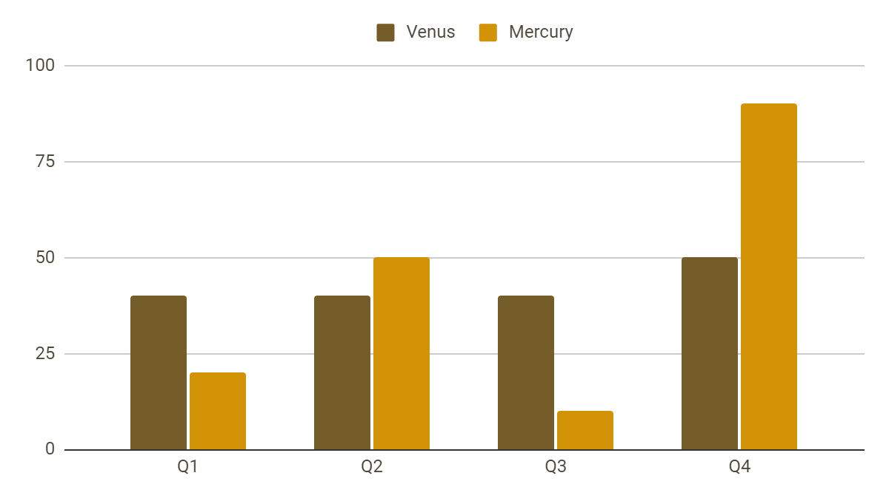
Analysis & development
Mercury is the closest planet to the Sun and the smallest one in the Solar System. This planet’s name has nothing to do with the liquid metal
The Sun is the star at the center of the Solar System
Jupiter is the biggest planet in the entire Solar System
Saturn is composed mostly of hydrogen and helium
Venus
Mercury
Venus has a beautiful name
Mercury is quite a small planet
Follow the link in the graph to modify its data and then paste the new one here. For more info, click here

Slide 17
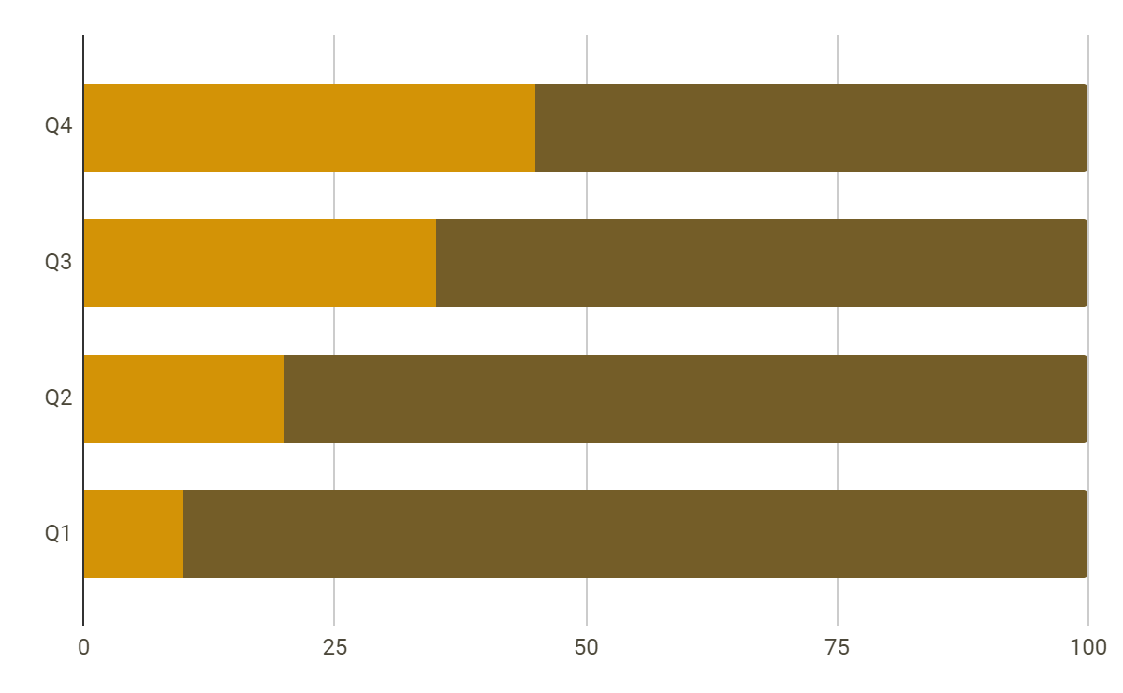
Analysis of the results
Mercury
Venus
Mercury is quite a small planet
Venus has a beautiful name
Mars
Despite being red, Mars is actually a cold place
50%
Follow the link in the graph to modify its data and then paste the new one here. For more info, click here

Slide 18
Discussion
Mars & Earth
1
Discussion 1
Despite being red, Mars is actually a cold place. It's full of iron oxide dust, which gives the planet its reddish cast. Earth is the third planet from the Sun and the only one that harbors life in the Solar System. We all live on this planet:
Ceres is located in the main asteroid belt
The Moon is Earth’s natural satellite
Neptune is very far from the Sun
Pluto is now considered a dwarf planet
Mercury is the closest planet to the Sun and the smallest one in the Solar System—it’s only a bit larger than the Moon
2
Discussion 2
Venus has a beautiful name and is the second planet from the Sun. It’s terribly hot—even hotter than Mercury

Slide 19
Conclusions
Mars
Venus
Despite being red, Mars is actually a cold place. It’s full of iron oxide dust
Venus has a very beautiful name and is the second planet from the Sun
Mercury
Neptune
Mercury is the closest planet to the Sun and the smallest one in the Solar System
Neptune is the fourth-largest planet by diameter in the Solar System

Slide 20
Thanks!
Do you have any questions?
youremail@freepik.com
+34 654 321 432
yourwebsite.com
Please keep this slide for attribution

Slide 21
Icon pack I

Slide 22
Icon pack II

Slide 23
Alternative resources
Here’s an assortment of alternative resources whose style fits that of this template:
Geometric background concept

Slide 24
Resources
Did you like the resources in this template? Get them at these websites:
Photos
White paper texture background
Icons
Icon Pack: Mental Health | Lineal
Icon Pack: History | Lineal
Illustrations
Young student learning in the library

Slide 25
Instructions for use
If you have a free account, in order to use this template, you must credit Slidesgo by keeping the Thanks slide. Please refer to the next slide to read the instructions for premium users.
As a Free user, you are allowed to:
Modify this template.
Use it for both personal and commercial projects.
You are not allowed to:
Sublicense, sell or rent any of Slidesgo Content (or a modified version of Slidesgo Content).
Distribute Slidesgo Content unless it has been expressly authorized by Slidesgo.
Include Slidesgo Content in an online or offline database or file.
Offer Slidesgo templates (or modified versions of Slidesgo templates) for download.
Acquire the copyright of Slidesgo Content.
For more information about editing slides, please read our FAQs or visit our blog:
https://slidesgo.com/faqs and https://slidesgo.com/slidesgo-school

Slide 26
Instructions for use (premium users)
As a Premium user, you can use this template without attributing Slidesgo or keeping the "Thanks" slide.
You are allowed to:
Modify this template.
Use it for both personal and commercial purposes.
Hide or delete the “Thanks” slide and the mention to Slidesgo in the credits.
Share this template in an editable format with people who are not part of your team.
You are not allowed to:
Sublicense, sell or rent this Slidesgo Template (or a modified version of this Slidesgo Template).
Distribute this Slidesgo Template (or a modified version of this Slidesgo Template) or include it in a database or in any other product or service that offers downloadable images, icons or presentations that may be subject to distribution or resale.
Use any of the elements that are part of this Slidesgo Template in an isolated and separated way from this Template.
Register any of the elements that are part of this template as a trademark or logo, or register it as a work in an intellectual property registry or similar.
For more information about editing slides, please read our FAQs or visit our blog:
https://slidesgo.com/faqs and https://slidesgo.com/slidesgo-school

Slide 27
Fonts & colors used
This presentation has been made using the following fonts:
DM Sans
(https://fonts.google.com/specimen/DM+Sans)
Lato
(https://fonts.google.com/specimen/Lato)
#4b4739
#745d28
#fdf9ed
#eedfb8
#d39306
#b19951
#bbae88
#ffffff

Slide 28

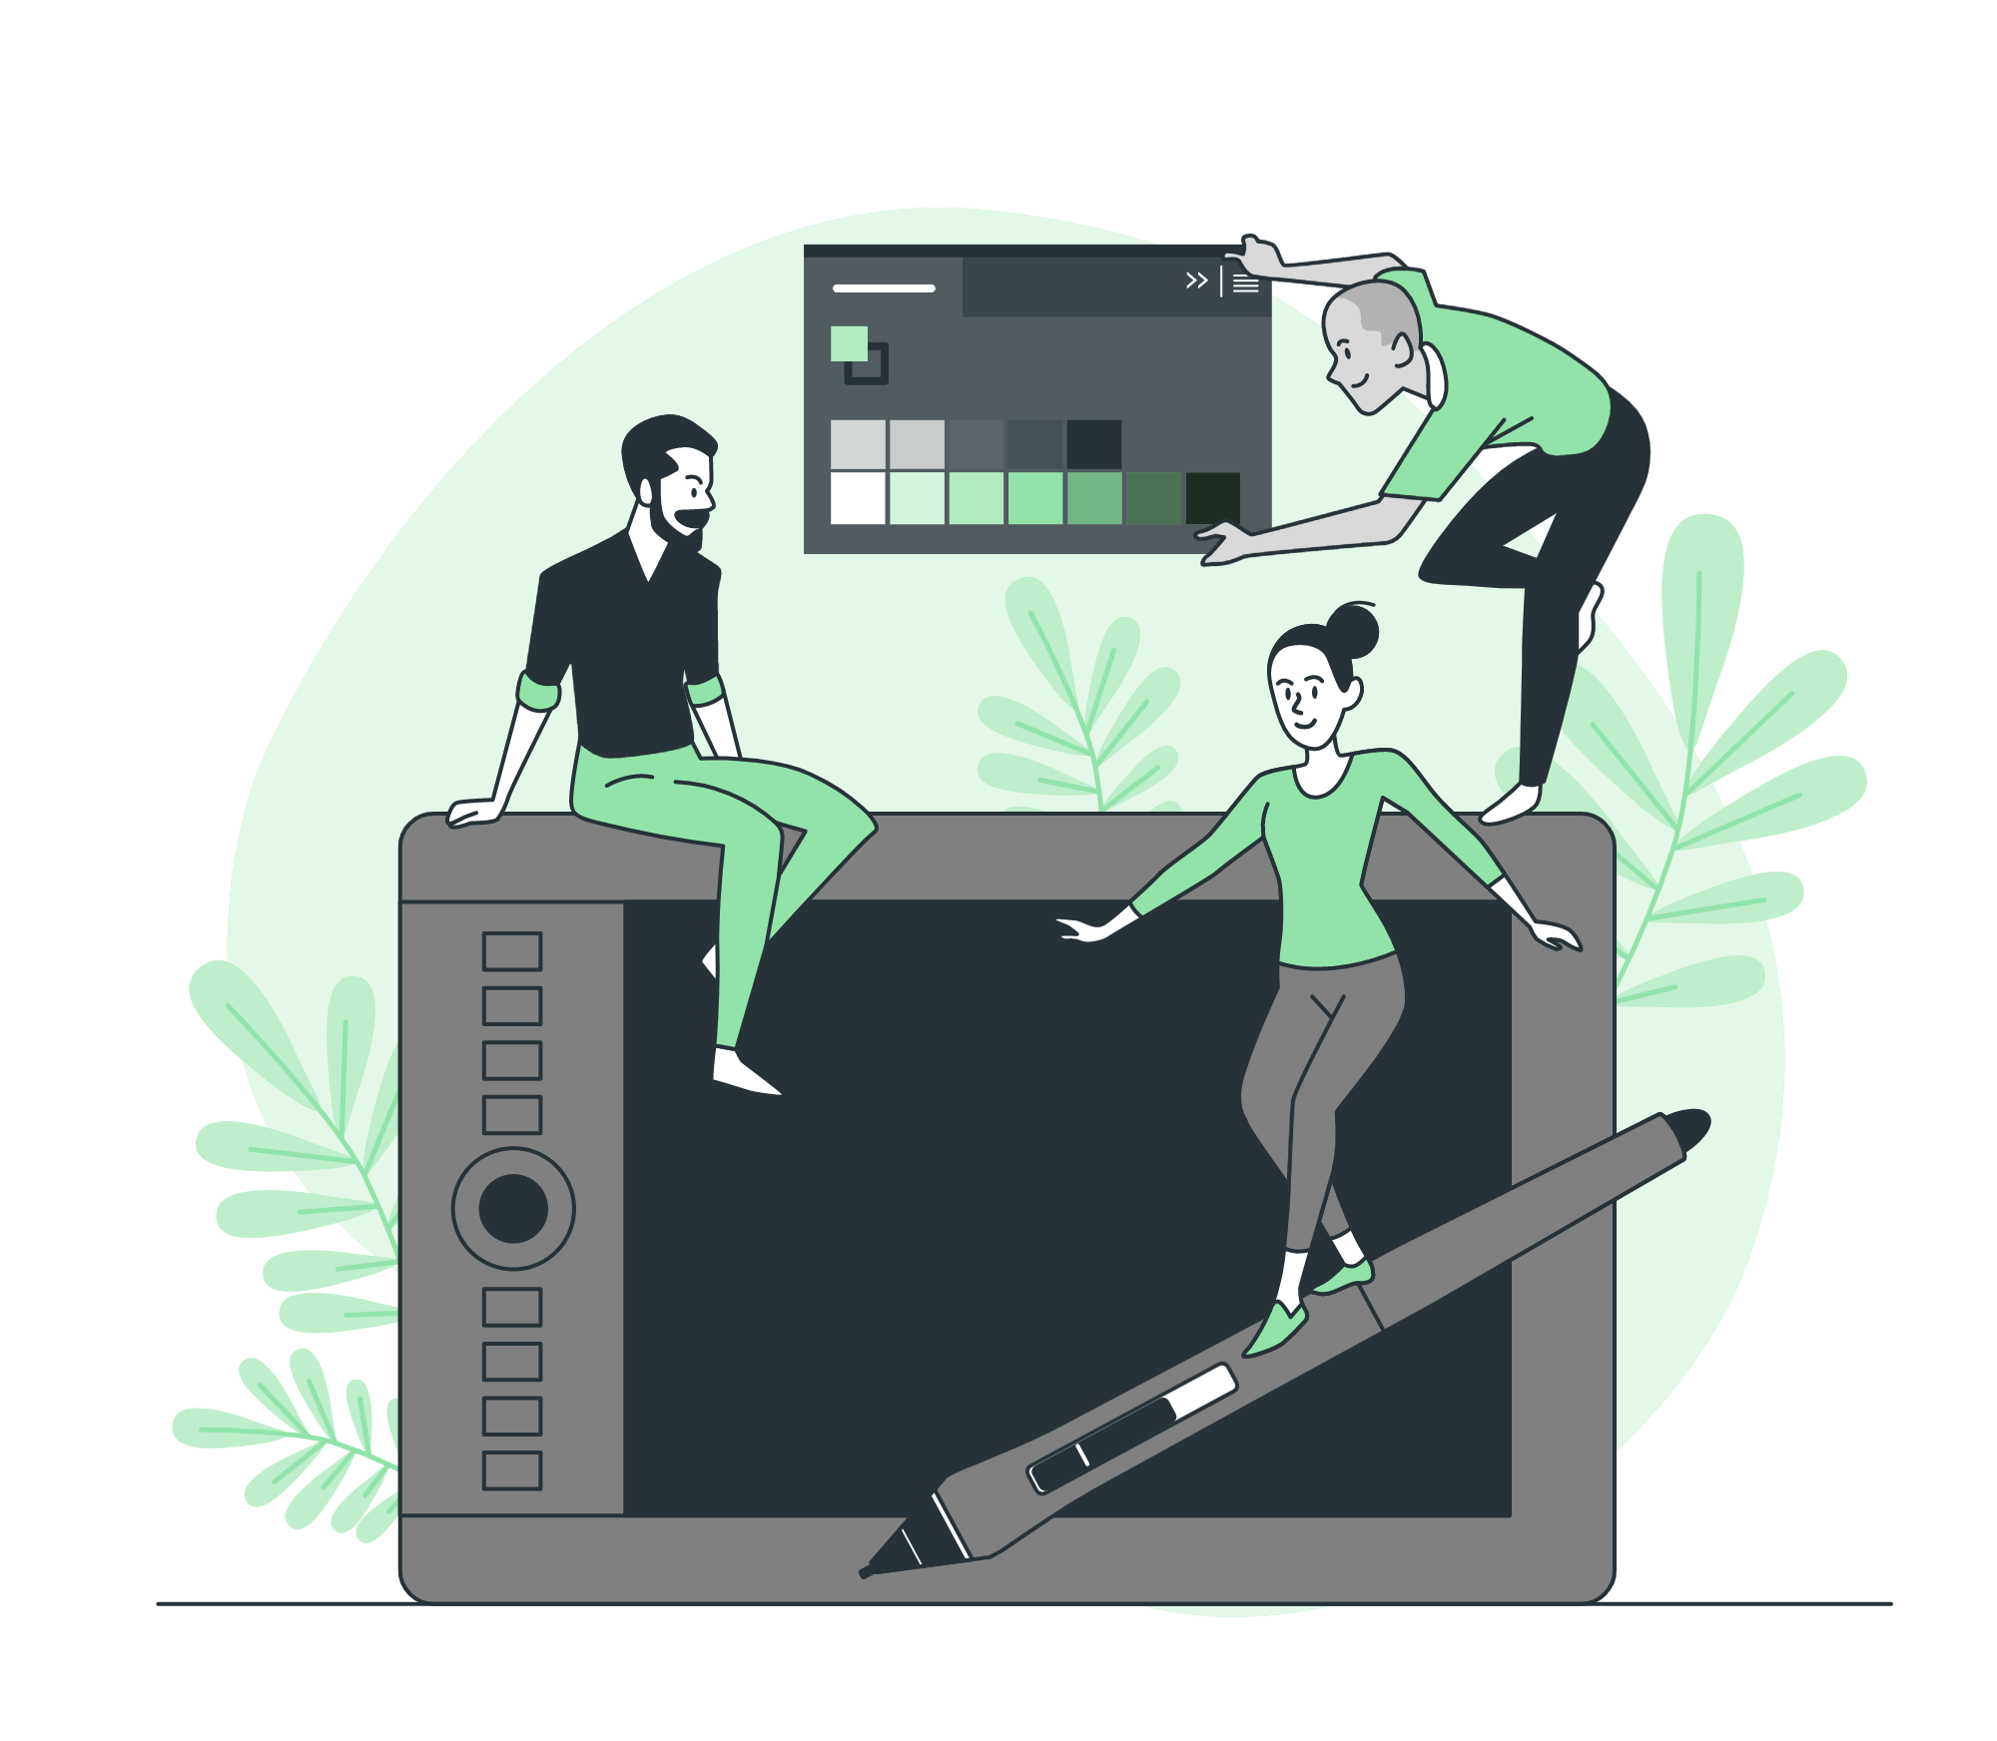



Storyset
Create your Story with our illustrated concepts. Choose the style you like the most, edit its colors, pick the background and layers you want to show and bring them to life with the animator panel! It will boost your presentation. Check out how it works.
Pana
Amico
Bro
Rafiki
Cuate

Slide 29
Use our editable graphic resources...
You can easily resize these resources without losing quality. To change the color, just ungroup the resource and click on the object you want to change. Then, click on the paint bucket and select the color you want. Group the resource again when you’re done. You can also look for more infographics on Slidesgo.

Slide 32
JANUARY
FEBRUARY
MARCH
APRIL
MAY
JUNE
PHASE 1
Task 1
Task 2
PHASE 2
Task 1
Task 2
JANUARY
FEBRUARY
MARCH
APRIL
PHASE 1
Task 1
Task 2

Slide 35
...and our sets of editable icons
You can resize these icons without losing quality.
You can change the stroke and fill color; just select the icon and click on the paint bucket/pen.
In Google Slides, you can also use Flaticon’s extension, allowing you to customize and add even more icons.

Slide 36
Educational Icons
Medical Icons

Slide 37
Business Icons
Teamwork Icons

Slide 38
Help & Support Icons
Avatar Icons

Slide 39
Creative Process Icons
Performing Arts Icons

Slide 40
Nature Icons

Slide 41
SEO & Marketing Icons

Slide 42


